Slide 1
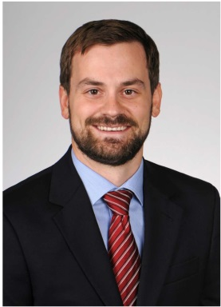
Intellectual Property relating to Drug and Device Development
ReGARDD 6.17.2020
By:
Scott Davis, PhD, Patent Agent
Director, Technology and Commercialization
MUSC Foundation for Research Development

Slide 2



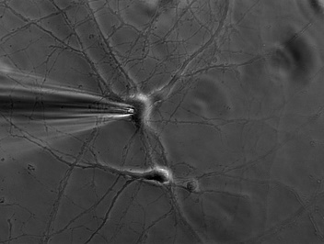
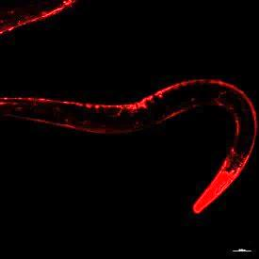
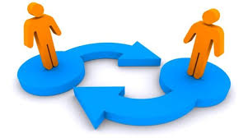


My own path to Technology Transfer

Slide 3
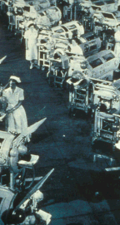
Devastating Effects of Polio
70% of people showed no symptoms, while ~1% result in paralysis
Early 1950s 13,000 to 20,000 paralytic cases were reported each year
Children younger than 5 years old more likely to contract virus
Notes:
Poliovirus (PV), an enterovirus belonging to the Picornaviridae family is the etiological agent of poliomyelitis, an acute paralytic disease. This disease results from lower motor neuron damage and is characterized by asymmetric persisting weakness (flaccid paralys
Polio paralyzed up to 20k children annually in pre-vaccine years
Enormous national effort where 80 million people donated money to the National Foundation for Infantile Paralysis

Slide 4
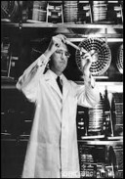
Should we be protecting our Intellectual Property?
There is no patent.
Could you patent the sun?
CBS Television Interview
On See It Now
(12 April 1955)
Notes:
Poliovirus (PV), an enterovirus belonging to the Picornaviridae family is the etiological agent of poliomyelitis, an acute paralytic disease. This disease results from lower motor neuron damage and is characterized by asymmetric persisting weakness (flaccid paralys
Polio paralyzed up to 20k children annually in pre-vaccine years
Enormous national effort where 80 million people donated money to the National Foundation for Infantile Paralysis
“When Jonas Salk asked rhetorically “Would you patent the sun?” during his famous television interview with Edward R. Murrow, he did not mention that the lawyers from the National Foundation for Infantile Paralysis had looked into patenting the Salk Vaccine and concluded that it could not be patented because of prior art

Slide 5
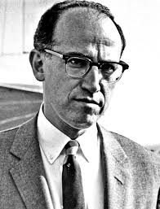




Truth behind the story
Attorneys for the National Foundation for Infantile Paralysis (NIPF) explored patenting vaccine
NIPF already committed to give innovation to several pharma companies for free before assessing for a patent
Salk himself patented an HIV vaccine for a startup he cofounded later in life
Early stage biomedical inventions are at an early stag/e and incredibly risky, and require a patent application in order for a company to develop

Slide 6
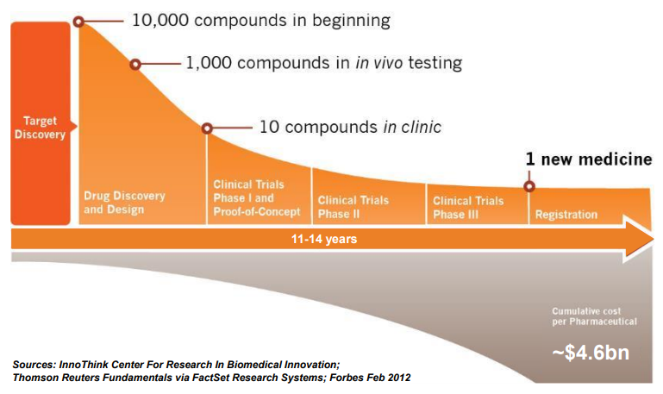
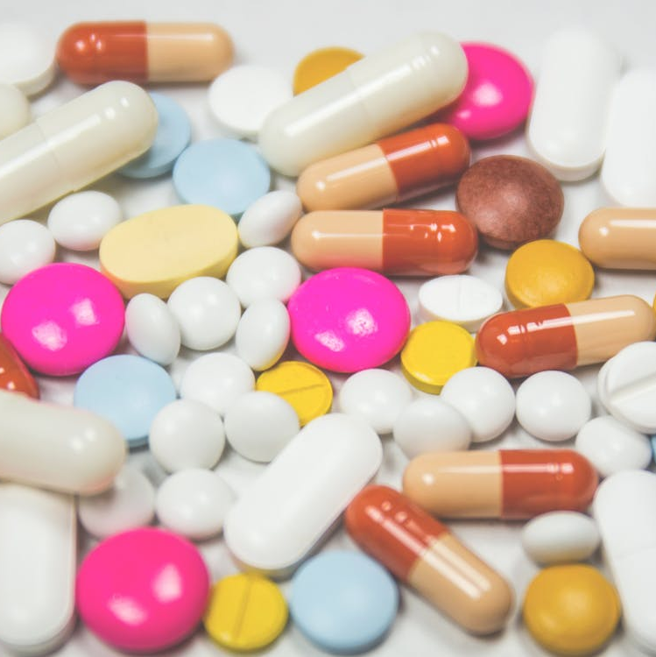
Cost to develop drugs
$1m
$15m
$17.5m
$40m
$150m
$40m
Adapted from Paul et al (2010) nat rev

Slide 7
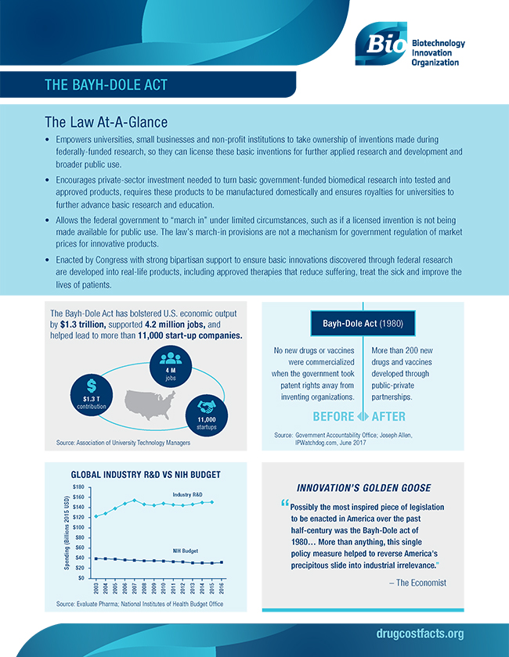


Bayh-Dole Act
Pre Bayh-Dole Act: 28,000 patents owned by Government
Federal government retained ownership and provided non-exclusive licenses to any interested party with research that had been federally funded
Bayh-Dole Act passed in 1980
Enabled University to retain title to inventions and take the lead in patenting/licensing
16 times as many patents filed by Universities today than in 1980
Licenses bring in upwards of $1 billion in revenue, which helps fund further research
Encourages needed industry R&D to turn basic government-funded biomedical research into tested and approved products
Responsible for ~600 new products being introduced per year
The Economist’s (2002) claimed: “[p]ossibly the most important piece of legislation to be enacted in America over the past half-century”

Slide 8
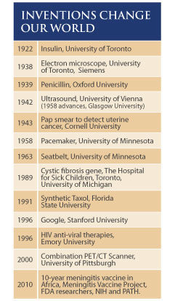
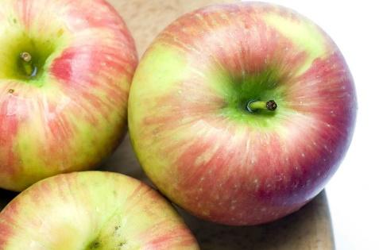



Groundbreaking Innovations from Universities!
Notes:
1991 – University of Minnesota Researchers Jim Luby and David Bedford developed Honeycrisp apples. After it came out the NYT called it “the iPod of apples”. Also has a great ability to survive harsh climates with a storage life around 7 months. This was patented in 1990 and brought in more than 14 million to UM. This money helped fund additional academic research in agriculture and in other areas.
1996 – Google Larry Page and Sergey Brin created an internet search engine called Page Rank, today known as google. Originally hosted on the Stanford University website in 1996, within 6 months the popularity overloaded Stanford’s bandwith shutting down the university internet access several times. They disclosed this invention to the technology transfer office, who was offered a non-exclusive license from a company. However, the director decided to provide the inventors an exclusive license to help them raise funds. This invention also being patented
1933 – Farmer found that clover his cows had been eating led to their death, and he brought samples of blood over to UW-Madison. After years of research the anticoagulant in the clover feed was found and they named it Warfarin. It ultimately became on of the most widley used rat poisens. Later it led to its use as a blood thinner and is now one of the most widely prescribed blood thinners in the world
1985 – Researcher Raymond Woosley at Georgetown brought in to look at current non drowsy anti-histamine and identified a breakdown product Fexofenadine. Went on to patent this and commercialized by Sanofi-Aventi. 2011 became OTC and totaled 221.6 million in sales.
2003- Filed patent application based on CART therapy focuses on reprogramming T-cells to target a protein called CD19 found in leukemia and lymphoma cells, and added a molecule that induces the T- cells to kill targetred cancer cells and causes the T-cells to proliferate. Licensed to Juno in 2013 and currently in clinical trials

Slide 9
Other benefits of Protecting University Intellectual Property (IP)?
Increases impact of University and Inventor
Promotes knowledge-Innovation economy
Supports innovation, entrepreneurship and knowledge
Increase research opportunities via collaborations and partnerships
University, inventor and lab income resulting from licenses to industry
Due to risk and cost to develop biomedical technologies, protecting University IP Increases partnership with industry which ultimately increases impact on society by reaching customers and patients
MUSC Distribution
First $10,000 of Net Proceeds to inventor(s), then:
Net Proceeds = Gross Proceeds – [Costs + 15% management fee]

Slide 10




What does a Technology Transfer Office do?
To facilitate the translation of discoveries into products and services for the public’s benefit
Aid in the creation of a climate of innovation that attracts and retains world-class faculty
Engage private sector for strategic partnerships
Contribute to economic development
Bench
Industry
Bedside
In short:

Slide 11
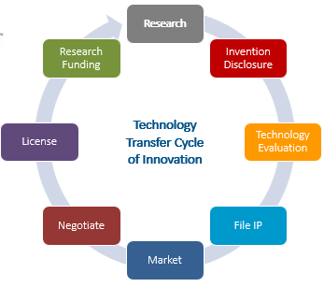
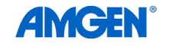
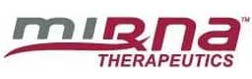






Cycle of Innovation
Existing Companies
Research
Invention Disclosure
Technology Evaluation
File IP
Market
Negotiate
License
Research Funding
Technology Transfer Cycle of Innovation
New Co. Startup

Slide 12
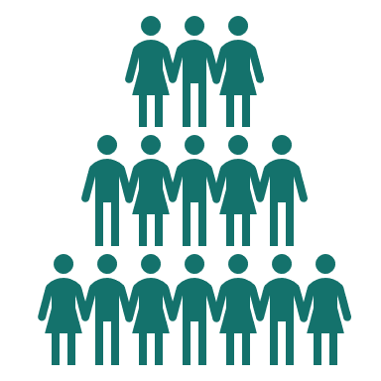

MUSC Intellectual Property (IP) Policy
Research
Invention Disclosure
Who? As a condition of your employment, studentship, and/or resource usage at MUSC you must assign ownership to MUSC
IP is required to be disclosed by employees and students
    Ownership is then determined
    Traditional academic copyrights owned by author(s)
    Employee - MUSC entitled to ownership if in field or MUSC resources utilized
    Student - MUSC entitled to ownership if IP invented during course of research at MUSC, utilizing MUSC resources, made in conjunction with others that must assign rights and/or preexisting commitments

Slide 13

How to you know what (and when) to disclose?
Research
Consider all types of Inventions
Invention Disclosure
Have you
Identified a need?
Gathered preliminary data to demonstrate POC?
Conducted a quick internet search to see if the idea is unique?
Do you plan or hope to continue development of the idea?
Disclose the idea to your tech transfer office before any public disclosures (disclosure outside university)

Slide 14
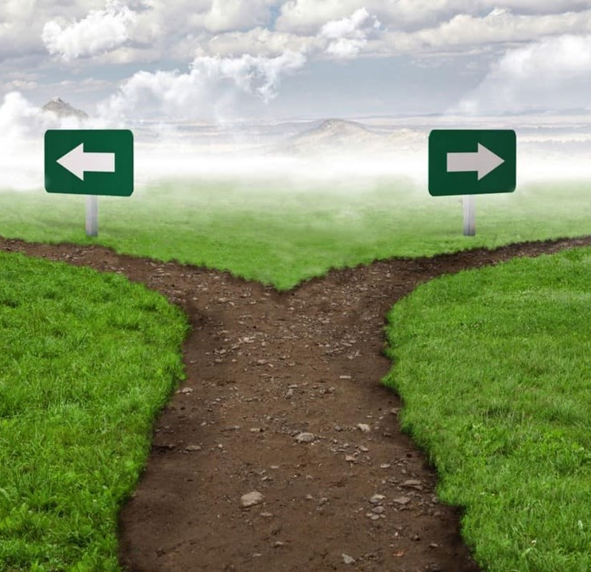


Criteria to Pursue
Technology Evaluation
Technical Merit
  Availability of data supporting invention
  Availability of clinical data or prototype
Protectability
  Can we protect the Intellectual Property?
  Expected freedom to practice
  Ability to detect infringement
Commercial Potential
  Market need
  Prospective licensee(s) identified / interested
  Competing technologies
  Predisposition of industry to licensing
  Regulatory and liability commercialization hurdles
Does reflect the likelihood that the technology will be able to generate commercial royalties and/or make public impact
Does not reflect a judgment of the quality of the science nor the scientific importance of the discovery.

Slide 15
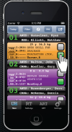
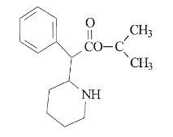
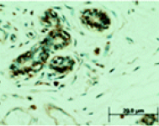
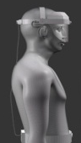
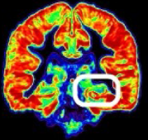
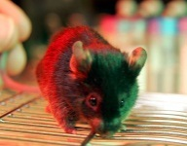
How is IP Protected?
File IP
Copyright Materials
Copyright
Therapeutics
Diagnostics
Patents
Medical Devices
Know How
Imaging & Algorithms
Research Tools, data

Slide 16
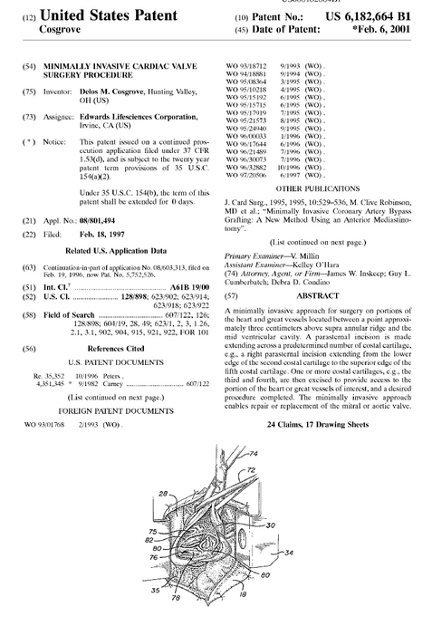
Patents
File IP
Trade off - Must fully describe the invention so that others know how to make & use it
  Community gains knowledge in trade for inventor to have a limited period of exclusivity of 20 years subject to PTA and PTE extensions
Power to prevent others from making, using, selling the idea or invention
Does NOT give your freedom-to-operate
Provides product credibility, helps gather investments and license work
  Required in many cases for company to develop a biomedical technology
Can be designed around
Average 3-5 patents per drug/med device
Notes:
Patent term Adjustment
Patent term extension

Slide 17
Patents
File IP
Requirements of Patentability
101: Utility
  useful/patentable subject matter
    Process, machine, manufacture, composition of matter, any new and useful improvement
    Difficulties with natural products, diagnostics and software
102: Novelty
  new, not previously known
103: Non-obviousness
  elements not already known with a motivation to combine
112: Enablement/Written Description
  the inventor is in possession of the invention at filing and the invention is fully described as to be reproducible by one skilled in the art.
Notes:
To promote the Progress of Science and useful Arts
Grants limited monopoly in exchange for a disclosure

Slide 18

102/103 - Be Aware of Public Disclosures
File IP
Manuscripts, public presentations(internal or external), dissertations, posters in public places
Grant abstracts for awarded federal grants are public disclosures
Otherwise available to the public
USA allows a 12 month grace period against disclosure of your own work, there is no such grace period for any other country
FRD will work with you to ensure you can publicly disclosure without delay and proceed with commercial opportunities

Slide 19
Examples of Patentable Subject Matter
File IP
Diamond_v._Chakrabarty: "include anything under the sun that is made by man“
Chemical composition
Non-naturally DNA, RNA, peptide molecule
Method of treating a disease/disorder
Drug delivery composition
Medical device for diagnosing or treating a disease/disorder
Notes:
In 1972, Ananda Chakrabarty filed a patent for a genetically modified bacterium that was capable of breaking down multiple components of crude oil. He developed this bacterium by engineering a way for multiple plasmids, each of which is able to break down different hydrocarbon components of the crude oil, to be incorporated into a single bacterium. The multiple plasmids would allow bacteria to break down oil from oil spills at a much quicker rate, and they would not be as affected by environmental conditions. The patent for this genetically modified bacterium that Chakrabarty filed contained three claims: How he produced the bacterium, an "inoculum composed of a carrier material and the bacterium", and the bacterial species itself. The first two claims were accepted, but the claim on the bacteria was rejected, under the grounds that the bacteria are naturally occurring, and as living organisms, cannot be patented.

Slide 20
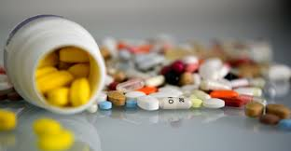

Examples of Therapeutic/Medical Device
US Patent Claims
File IP
Drug composition
Formula
Method of manufacture
Method of treatment
Combination therapies
Process
Device
Material used
Medical device system
Method of using the device
Notes:
In 1972, Ananda Chakrabarty filed a patent for a genetically modified bacterium that was capable of breaking down multiple components of crude oil. He developed this bacterium by engineering a way for multiple plasmids, each of which is able to break down different hydrocarbon components of the crude oil, to be incorporated into a single bacterium. The multiple plasmids would allow bacteria to break down oil from oil spills at a much quicker rate, and they would not be as affected by environmental conditions. The patent for this genetically modified bacterium that Chakrabarty filed contained three claims: How he produced the bacterium, an "inoculum composed of a carrier material and the bacterium", and the bacterial species itself. The first two claims were accepted, but the claim on the bacteria was rejected, under the grounds that the bacteria are naturally occurring, and as living organisms, cannot be patented.

Slide 21
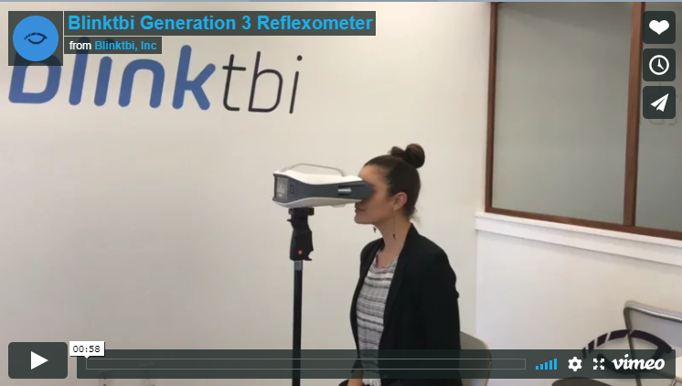
Blink Reflexometer
File IP
Delivers eye puffs and uses high-speed videography to record blink reflex
Objective data to detect concussions
MUSC PI lead Dr. Nancey Tsai, and a ZIAN project
Licensed to BlinkTBI, initially partnered with the Citadel

Slide 22
Patents
File IP
Patent Prosecution
2-6 years
US/PCT
Application published
6 months after filing non-provisional (18 months from priority)
File US and/or PCT patent application 12 mo.
Examination
12-48 months
3.5 yrs.
7.5 yrs.
11.5 yrs.
US
route
6-18 mo.
Office Action Received
3 mo. Response to Office Action Due
Patent
Granted
Patent
rejected
Maintenance Fees Due
Provisional Patent Application Filed
PCT
route

Slide 23
Patents
File IP
Patent Prosecution
2-6 years
US/PCT
Application published
6 months after filing non-provisional (18 months from priority)
File US and/or PCT patent application 12 mo.
Examination
12-48 months
3.5 yrs.
7.5 yrs.
11.5 yrs.
US
route
6-18 mo.
Office Action Received
3 mo. Response to Office Action Due
Patent
Granted
Patent
rejected
Maintenance Fees Due
Provisional Patent Application Filed
PCT
route
Maintenance Fees Due
US
Europe
4 mo.
International search report (ISR) and written opinion (WO)
18 mo.
Must elect areas for national phase
Foreign countries
(Ex. Canada, Japan, Mexico, etc.)
Patent
rejected
20 yrs. after nonprovisional/PCT filed, patent term is over

Slide 24


Cost and time associated with patents
File IP
Typical Patent Process Money Time
Provisional Patent Filing ~5k
U.S. Utility Filing & Prosecution ~20k
National Stage (if filing outside US) >100k
Issuance of patent claims $$ - $$$$
Maintaining applications $ - $$
Defending patents and stopping infringers $$$ - $$$$$
12 months
30 months
2.5 – 20 years
Notes:
Provisional – do not want to filed until within 1 year window of having supporting data to be market ready; once converted, costs grow significantly
Provisional: couple thousand
PCT/Utility: additional 5-10k to file (no prosecution responses)
about $25k to get issued claims in the US
Few 100 thousand to get international claims

Slide 25
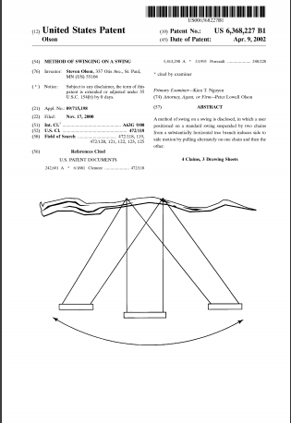
Commercial value of patent
File IP
Can you prove that someone is infringing on your IP?
Are you able to enforce rights against those people?
Would it make economic sense to pursue lawsuit? Commercial value of patent vs. enforcement costs
Are people willing to pay
Method of swinging on a swing US 6368227
Notes:
Hatch-Waxman exemption– Performing research and tests for preparing regulatory approval does not constitute infringment
Ex. Generic manufactures can prepare drugs in advance of patent expiration
Common law research exemption- can used patented invention for research purposes, such as at a University
Further public uni soverign immunity

Slide 26
Freedom-to-operate
File IP
Right to prevent others from
Making
Using
Selling
invention in country of patent
It does NOT give you the right to make/use/sell it yourself.
Freedom-to-Operate

Slide 27
Hatch Waxman Amendment 1984
File IP
The Drug Price Competition and Patent Term Restoration Act - better known as the Hatch-Waxman Act (HWA), is a comprehensive legal framework enacted by Congress in 1984 to streamline the process for generic pharmaceutical approvals
Preserve incentives for innovation (exclusivity), including the creation of a procedure for patent litigation involving generic pharmaceuticals.
Resource: https://www.fda.gov/drugs/abbreviated-new-drug-application-anda/hatch-waxman-letters

Slide 28
Patent-Term Extensions & Exclusivities
File IP
New brand-name drugs are usually protected by patent which prohibit others from selling generic versions of the same drug during term
Under the HWA, brand-name companies receive patent term extension to account for the time the patented product is under review by FDA for regulatory approval, to restore that time
  Products could include human and veterinary pharmaceuticals, food additives, color additives, medical devices etc.,
  Decision to extend made by USPTO in conjunction with FDA
  Sum of one half of the time in testing phase +half the time in review phase, can’t exceed 5 years alone or 14 years of time in combination with patent term
  Application needs to be filed with in 60 days after regulatory approval
An interim extension can be obtained if approval exceeds patent term

Slide 29
Patent-Term Extensions & Exclusivities
File IP
Exclusivity refers to certain delays and prohibitions on approval of competitor drugs available under the statute that attach upon approval of a drug or of certain supplements
HWA includes provisions that involve patents and exclusivities related to new drug applications and 180 day exclusivities to certain ANDA applications
  Orphan Drug - 7 years
  New Chemical Entity – 5 years
  Generating Antibiotic Incentives Now Gain Exclusivity – 5 years added to certain exclusivities
  Pediatric exclusivity (PED) – 6 months added to existing patents/exclusivity
  Patent Challenge (PC) – 180days
  Competitive Generic Therapy – 180 days

Slide 30
Identify Licensee and Market
Market
Technology Transfer Offices (TTOs) generally do not have the ability to shoulder patent costs for IP
Universities generally do not have the capabilities to reach the market in the life science space
Companies rely on inventions from academic research as a basis for commercial research programs
Overall, this creates a natural fit for the University to license their nascent technologies to companies who can continue development

Slide 31
Identify Licensee and Market
Market
Existing Company
Startup
Maturation
Market
Prepare marketing materials for the technology
  Non-confidential Summary
  Company List
Direct Marketing
  Market Research
  Tech Transfer Contacts
  Inventor Contacts
Formation of a startup company with an inventor
Identify resources to further develop technology
Internal development funding opportunities
Industry Sponsored Research

Slide 32
Negotiate and License
Negotiate
License
Negotiating a License or Option
  Can take 3-12 months
  Financial components are only one part
  Not just the licensee and licensor
Components of an Option
  Upfront fee, patent expense reimbursement and ongoing patent costs (sometimes), option exercise fee
  “Test Drive” a technology for a period of time (often used with faculty startups to allow for SBIR/STTR or other funding opportunities)
Components of a License
  Upfront fee, minimum annual royalty, earned royalties, patent expense reimbursement
  Diligence and Reporting
  Patent prosecution and protection
  Sublicensing
  Termination
  And more!

Slide 33
License Revenue Distribution
Research Funding
First $10,000 of Net Proceeds to inventor(s), then:
Net Proceeds = Gross Proceeds – [Costs + 15% management fee]
*For Disclosures submitted on or after April 7, 2016

Slide 34
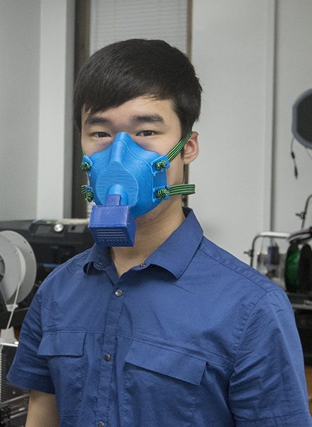
Protecting IP is necessary to develop technologies – but we remain flexible
Guiding Principles of Technology Transfer as it relates to COVID-19
  Licensing strategy that facilitates rapid pandemic response by making transactions top priorty
  Adpoting time-limited royalty free licenses in exchange for commitment to rapidly and broadly distribute technologies
  Subsequent conversion to more typical commercial license as appropiate
FRD has received 16 COVID disclosures that range from diagnostics, medical devices, therapeutics and copyrights
Researchers at MUSC created a respirator mask and cartridge that are reusable and address PPE shortages. It has been made publicly available for 3D printing at: https://web.musc.edu/innovation/covid-19-innovation/safe-cartridge-system-and-masks
SimTunes, LLC made a series of training videos on how to respond to a pandemic such as COVID-19 in partnership with MUSC. Videos have been made available for the public and MUSC:
https://www.youtube.com/channel/UCzl4VwFweBQxvetSXapBvIQ

Slide 35
Role of researchers during tech transfer process
Work with the Tech Transfer Office (TTO) to evaluate technology and determine the best commercialization pathway
Disclosing all new data and improvements to the TTO in a timely manner
  Negative data can be really useful in the case of patent applications
Making the TTO aware of what you know about other related work in the area
Read through Patent applications at the direction of the TTO, help rebut USPTO rejections, make yourself available to the TTO and patent attorneys if needed
Help the TTO market the technologies, and provide an appropriate level of help to licensee to ensure technology development
Notes:
5 m 41s

Slide 36

Role of TTO during tech transfer process
Identify and encourage disclosures of new technologies that could be commercialized
Work with the researchers and stakeholders to evaluate technology and determine the best commercialization pathway
Ensure intellectual property protection of technologies
Identify existing companies that will commercialize technology
  Or support formation of, and nurture startups being spun out of the University
Negotiate a fair market deal for technologies through licensing, which also requires development and utilization of the technology
Ensure compliance of the licensee
Notes:
3m

Slide 37
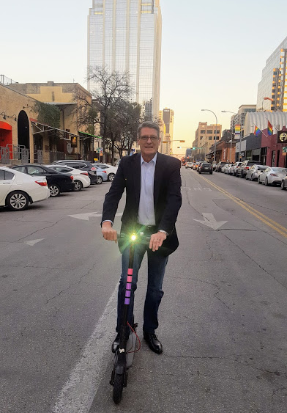




Benefits of working with a TTO
TTO pays initial patent costs for technologies
Protecting and Commercializing Technologies
TTO officers are experts in intellectual property protection and licensing industry connections
Sponsored Research Funding, industry collaborations, commercializing technologies developed at University
Technology Maturation Programs
SBIR/STTR program
Directing to relevant funding
Internal funds
Complying with IP policy

Slide 38
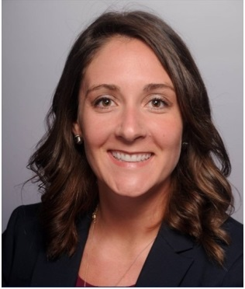
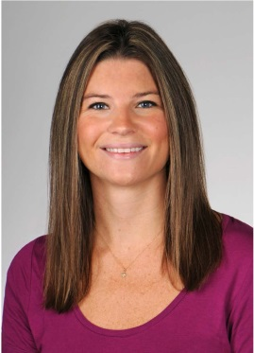
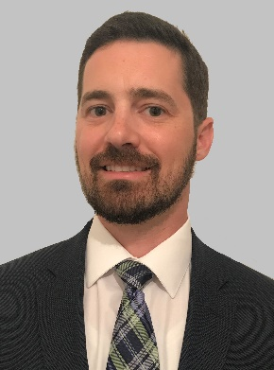
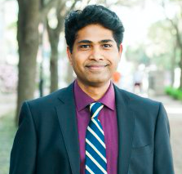
FRD Case Management Staff
Contact info:
  Telephone: 843-876-1900
  135 Cannon Street Suite 101L
  Website - http://frd.musc.edu
Researchers at MUSC created a respirator mask and cartridge that are reusable and address PPE shortages. It has been made publicly available for 3D printing at: https://web.musc.edu/innovation/covid-19-innovation/safe-cartridge-system-and-masks
Michael Rusnak
Executive Director
rusnak@musc.edu
Brooke Trevino
Executive Assistant
revinob@musc.edu
Deanne Lucas, CPA
Chief Financial Officer
lucase@musc.edu
Pamela Kaufman
Senior Intellectual Property Manager
kaufmanp@musc.edu
Scott Davis, PhD
Director, Technology and Commercialization
davissco@musc.edu
Chelsea Ex-Lubeskie, MS
Sr. Business Development Manager
exlubesk@musc.edu
Casey Charbonneau, JD
Technology Transfer and General Counsel’s Attorney
edwardsr@musc.edu
Troy Huth, JD, PhD
Associate Director
huth@musc.edu
Shan Selvam, PhD
Technology Transfer Associate
panneers@musc.edu

Slide 39



Technology Maturation – How do we do it?
SCRA
FRD
Prototyping
Fund
FRD
TAC

Slide 40
FRD Impact FY2020
$49.20MM Total
$497K Licensing
$348K to
MUSC
$149K to
FRD
$47.96MM
Technology Development
$748K Other
$133K Other
$1.82MM
Non-dilutive
$46MM Dilutive
$1.02MM to Startup
$801K to MUSC
$133K MUSC
$3K to MUSC
$47.82MM to
Startups
$1.28MM to MUSC

Slide 41
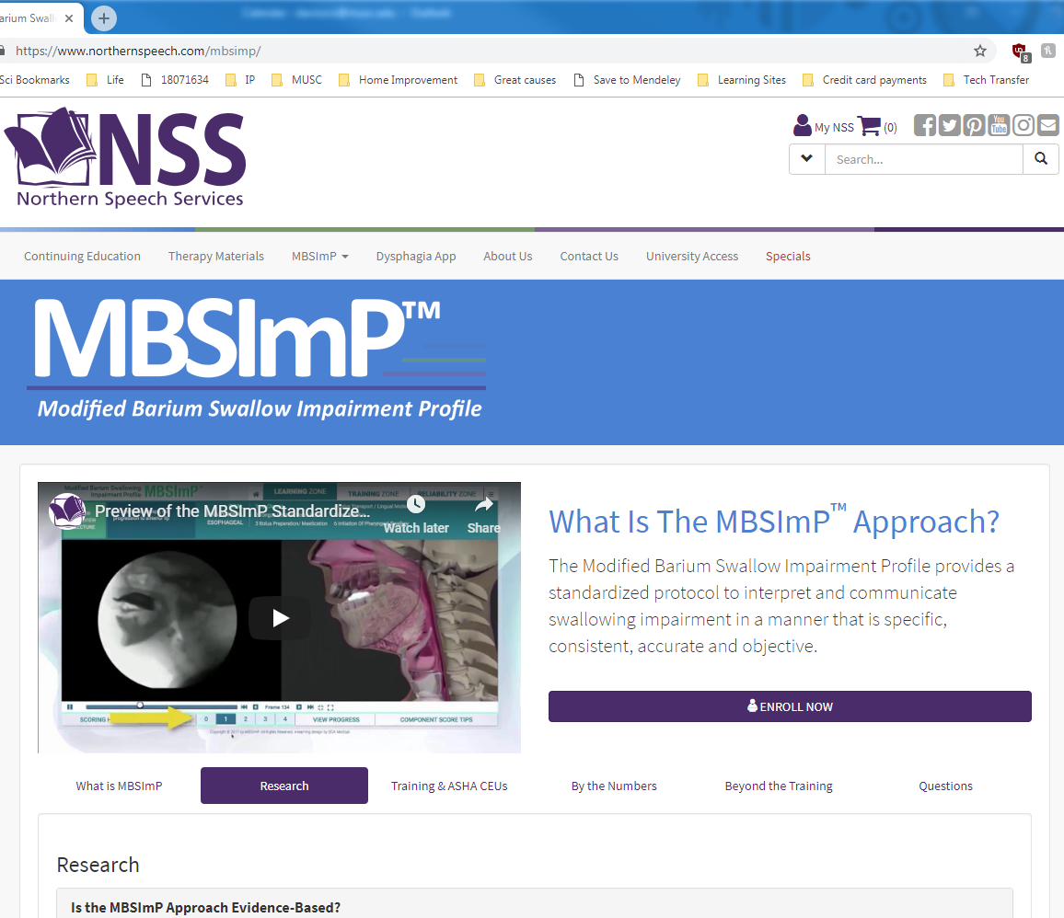
Examples of Impact of MUSC Innovation
MUSC Inventions | Company
The Modified Barium Swallow Impairment Profile | Northern Speech Services
Health care simulation | SimTunes
MicruSphere 3D coil ® | Micrus Endovascular
Endoscopic Suturing System | Apollo Endosurgery
Blink Reflexometer-a concussion detector | Blinktbi
The Modified Barium Swallow Impairment Profile, or MBSImP, is a standardized approach to instruction, assessment, and reporting of physiologic swallowing impairment
  Can detect narrowing or irritation of the esophagus, swallowing disorders, ulcers, tumors/polyps and GERD
  This comprehensive online training program teaches speech-language pathologists a standardized protocol used in assessment of patients who have swallowing disorders (dysphagia).
Developed by Dr. Bonnie Martin-Harris at MUSC
Distributed by Northern Speech Services since 2011, enrolling over 7,000 speech-language pathologists in 25 countries and adopted by over 150 Universities into curriculum

